Slide 1


Harm reduction services in prisons: gaps, challenges and good practice examples
Heino Stöver
Frankfurt University of Applied Sciences/Germany

Slide 2
I declare to have no conflicts of interest

Slide 3
HIV in Prisons
People Who Inject Drugs and Infectious Diseases in prisons¹
  HIV, STI, hepatitis B&C and TB prevalence
  2 - 15 times higher
  TB incidence rates
  23 times higher
Ukraine 15X
Argentina 10X
South Africa
& USA 2X
Community
1 UNAIDS Gap Report 2014

Slide 4
HIV-Prevention – The Comprehensive Package: 15 Key Interventions (UNODC et al. 2012)
1. Information, education and communication
2. HIV testing and counselling
3. Treatment, care and support
4. Prevention, diagnosis and treatment of tuberculosis
5. Prevention of mother-to-child transmission of HIV
6. Condom programmes
7. Prevention and treatment of sexually transmitted
infections
8. Prevention of sexual violence
9. Drug dependence treatment => Opioid Substitution Treatment
10. Needle and syringe programmes
11. Vaccination, diagnosis and treatment of viral hepatitis
12. Post-exposure prophylaxis
13. Prevention of transmission through medical or dental services
14. Prevention of transmission through tattooing, piercing and
other forms of skin penetration
15. Protecting staff from occupational hazards
¹UNODC/ILO (2012): HIV prevention, treatment and care in prisons
and other closed settings: a comprehensive package of interventions
Notes:
The comprehensive package consists of 15 interventions that are essential for effective HIV
prevention and treatment in closed settings. While each of these interventions alone is useful
in addressing HIV in prisons, together they form a package and have the greatest impact
when delivered as a whole.

Slide 5
Information, education and communication

Slide 6
Website www.harmreduction.eu
    Sustainable website
    Toolbox and E-Learning courses:
  Harm Reduction
  Opioid Substitution Treatment
  Prison-based Needle and Syringe Programme
  Condom Distribution
  Take-Home-Naloxone on Release (to come)
Notes:
10.35 million people held in prisons, more than one third of them are in pre-trial detention. The annual global prison population is significantly greater due to the high turnover; most prisoners return to the community, many in less than a year. In addition, the global incarceration rate has risen by 6% over the past 15 years to reach a staggering 144 per 100,000 Furthermore many prisons across the world are overcrowded with 113 countries noted as having a prison occupancy of more than 100%, including 22 with an occupancy above 200%. Overcrowded prisons and a bigger overall prison population, along with a high turnover, lead to an increased risk of transmission of infectious diseases not only between people in prisons, but also an increased risk of transmission in the wider community.
King’s college (2016), Prison Population List (11th Edition) - http://www.prisonstudies.org/sites/default/files/resources/downloads/world_prison_population_list_11th_edition.pdf
King’s college (2013), Prison Population List (10th Edition) - http://www.prisonstudies.org/sites/default/files/resources/downloads/wppl_10.pdf

Slide 7
Sexual Risks and Condom Programs

Slide 8
Condoms: from Maputo (Mozambique) to Munich (Gemany) to Maseru (Lesotho)
Maputo/Mozambique: ca. 24% of prisoners HIV+ - no condoms: „…might increase sexual activity …“
Munich/Germany: HIV-prevalence among prisoners 1,5% of men, that is 30-times higher than in the general population
condoms available only via application – medical service
2005-2007 provision of 43 condoms to 13,000 prisoners
Official legitimation: „prisoners are informed to behave responsibly right in the beginning“¹
Lesotho prison service has installed „condotainer“
¹Bayerische Staatszeitung vom 29.08.2014

Slide 9
Condom Provision - HA-REACT
    Pilot Condom Distribution in Czech Prison via automats
    Scientific evaluation of needs and functioning
    Development of prevention material
    Scientific paper
    Guidance – Manual
    Condom Summit 17 January 2019
Notes:
10.35 million people held in prisons, more than one third of them are in pre-trial detention. The annual global prison population is significantly greater due to the high turnover; most prisoners return to the community, many in less than a year. In addition, the global incarceration rate has risen by 6% over the past 15 years to reach a staggering 144 per 100,000 Furthermore many prisons across the world are overcrowded with 113 countries noted as having a prison occupancy of more than 100%, including 22 with an occupancy above 200%. Overcrowded prisons and a bigger overall prison population, along with a high turnover, lead to an increased risk of transmission of infectious diseases not only between people in prisons, but also an increased risk of transmission in the wider community.
King’s college (2016), Prison Population List (11th Edition) - http://www.prisonstudies.org/sites/default/files/resources/downloads/world_prison_population_list_11th_edition.pdf
King’s college (2013), Prison Population List (10th Edition) - http://www.prisonstudies.org/sites/default/files/resources/downloads/wppl_10.pdf

Slide 10
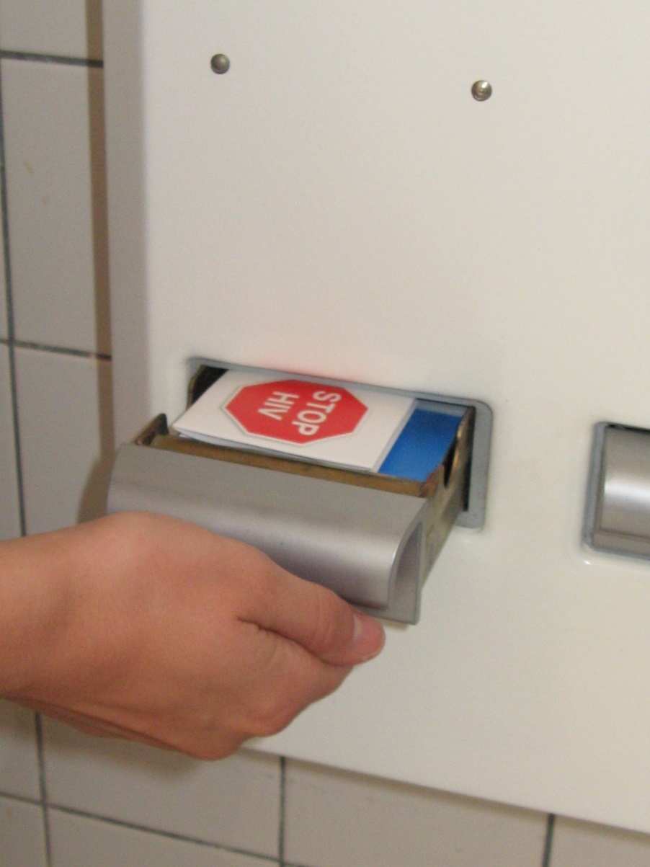
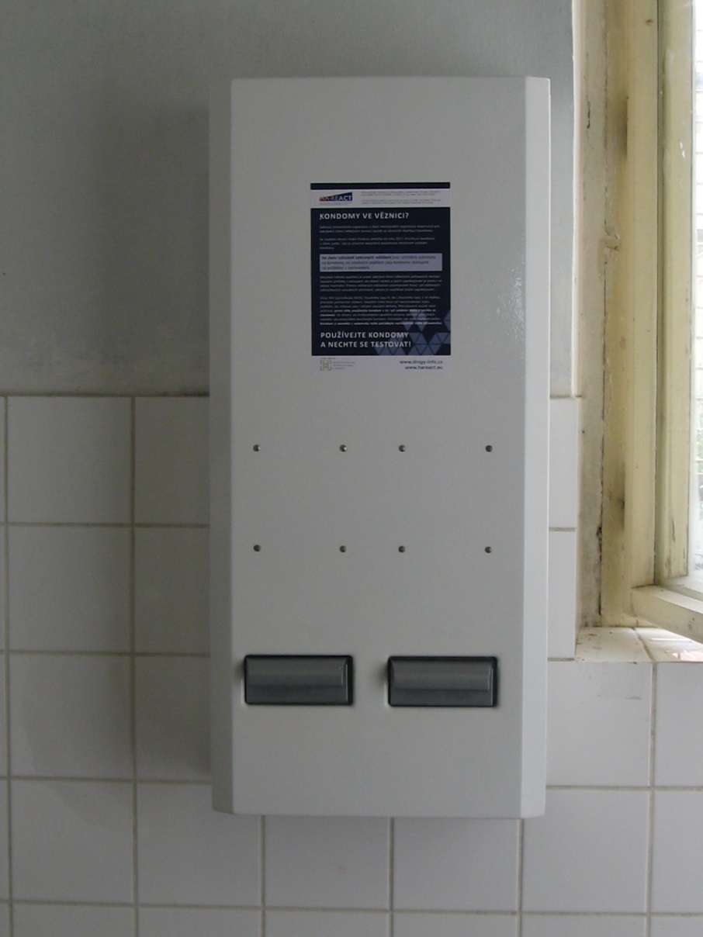
Condom distribution via automats: Prague/Czech Republic
Photos: Victor Mravcik

Slide 11
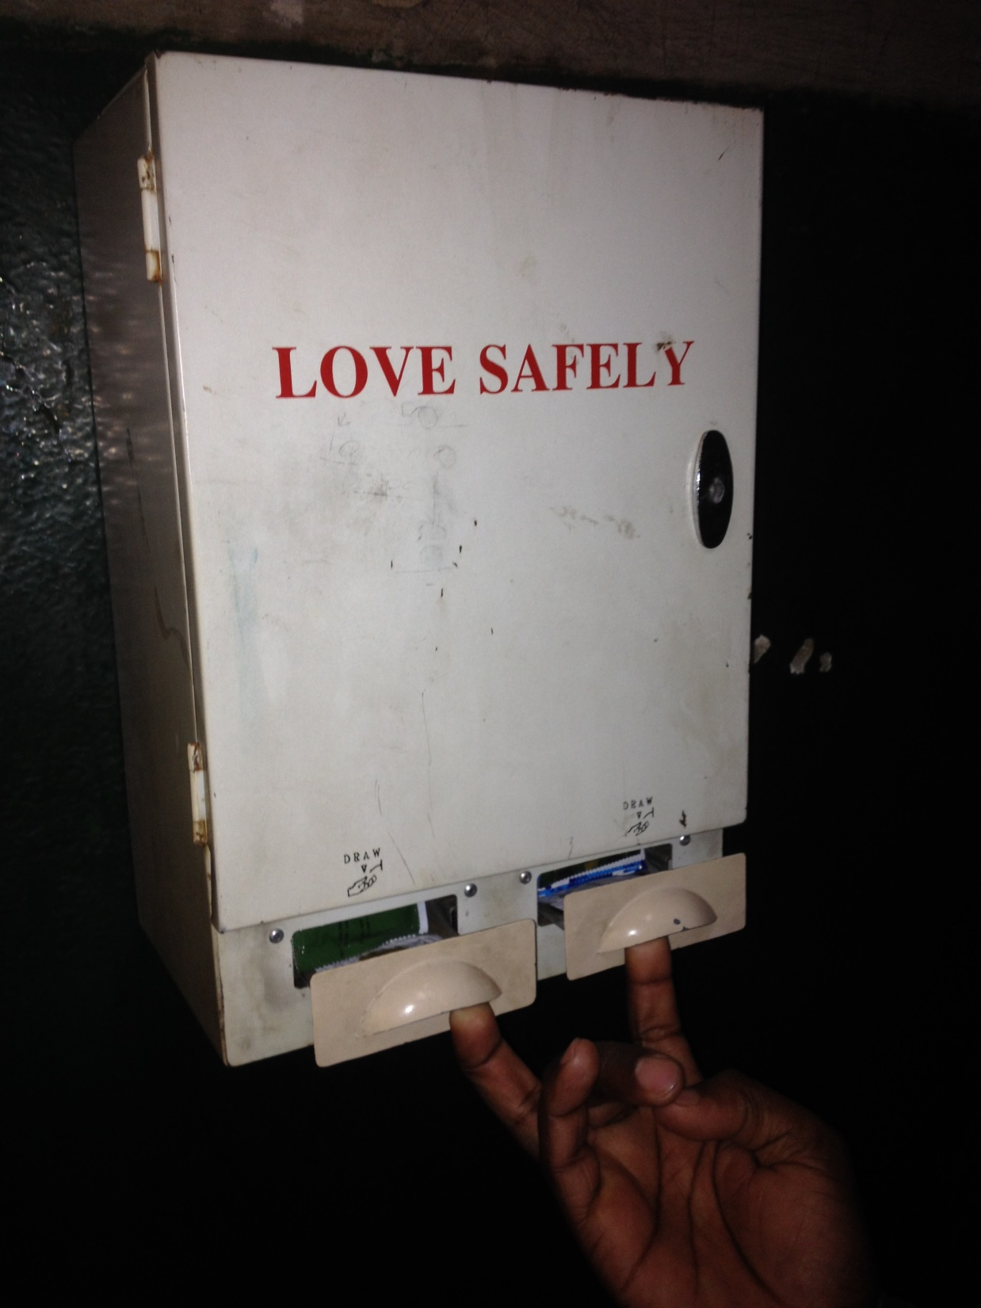
Condotainer Maseru/Lesotho Prison

Slide 12
Opioid Substitution Program

Slide 13
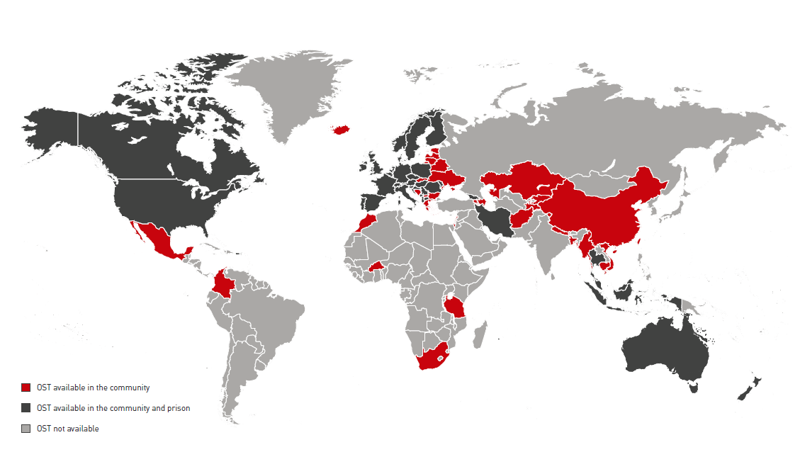
OST in Community & Prison worldwide¹
1 HRI (2015): The Global State of harm reduction

Slide 14
The PNSP Manual (1/3)
Systematic OST review of prison¹
Review of 21 studies (incl. 6 RCTs) shows that OST is effective among the prison population:
++ reduced heroin use, injecting and syringe-sharing in prison, if doses adequate;
++ increases in treatment entry and retention after release;
++ post-release reductions in heroin use;
+ pre-release OST reduces post-release deaths;
+/- evidence regarding crime and re-incarceration equivocal;
? lack of studies addressing effects on incidence HIV/HCV;
Disruption of continuity of treatment, especially due to brief periods of imprisonment, associated with very sigificant increases in HCV incidence.
1 Hedrich et al. 2012; Addiction
Notes:
14
The principle of equivalence
The principle of equivalence means that the health care measures (medical and psychosocial) successfully proven and applied outside prison should also be applied inside prison. With regard to support for drug using inmates in many ways this has turned out as wishful thinking. In most of the countries already basic prerequisites are not given (i.e., no throughcare of treatment, no adequate prevention means).
Nevertheless the principle of equivalence is the guiding criteria, with which prison drug services have to be measured in the context of the national drug service structure and the drug policies pursued in all EU member states. Especially the differentiation of drug services (including drug free treatment, methadone maintenance and harm reduction) outside is not reflected sufficiently inside prison. ‘Prison Health’ has to be integrated in the broader frame of ‘Public Health’.

Slide 15
The PNSP Manual (1/3)
30y OST in European prisons
Where have we got from here?
Coverage still low in many countries
Detoxification models heterogenous
Maintenance varies
OST as relapse prevention only in few countries
OST provision in prisons varies:
from country to country,
from region to region,
from prison to prison,
from doctor to doctor within the same prison
Notes:
15
The principle of equivalence
The principle of equivalence means that the health care measures (medical and psychosocial) successfully proven and applied outside prison should also be applied inside prison. With regard to support for drug using inmates in many ways this has turned out as wishful thinking. In most of the countries already basic prerequisites are not given (i.e., no throughcare of treatment, no adequate prevention means).
Nevertheless the principle of equivalence is the guiding criteria, with which prison drug services have to be measured in the context of the national drug service structure and the drug policies pursued in all EU member states. Especially the differentiation of drug services (including drug free treatment, methadone maintenance and harm reduction) outside is not reflected sufficiently inside prison. ‘Prison Health’ has to be integrated in the broader frame of ‘Public Health’.

Slide 16
European Court of Human Rights in the case of Wenner vs. Germany
manifest and long term dependence to opioids
denial of opioid substitution treatment (OST) in Bavarian/German prison
The Court found that the physical and mental strain that Mr Wenner suffered as a result of his untreated or inadequately treated health condition could, in principle, amount to inhuman or degrading treatment.
the failure to adequately assess Mr. Wenner’s treatment needs involved a violation of the prohibition of inhuman or degrading treatment
Notes:
16
complaint by a long-term heroin addict that he had been denied opioid substitution treatment (OST) in prison. The European Court of Human Rights acknowledged strong indications that substitution treatment could be regarded as appropriate for the applicant given his manifest and long term addiction to opioids and its enduring health consequences. The Court also found that the physical and mental strain that Mr Wenner suffered as a result of his untreated or inadequately treated health condition could, in principle, amount to inhuman or degrading treatment. The Court concluded that the failure to adequately assess Mr Wenner’s treatment needs involved a violation of the prohibition of inhuman or degrading treatment.
The case of Wenner vs. Germany made its way in the European Court of Human Rights. The judgment of the European Court of Human Rights in this case delivered on 1 September 2016 was important for drugs (and substitution) treatment in prison:
The case concerned the complaint by a long-term heroin addict that he had been denied opioid substitution treatment (OST) in prison. The European Court of Human Rights acknowledged strong indications that substitution treatment could be regarded as appropriate for the applicant given his manifest and long term addiction to opioids and its enduring health consequences. The Court also found that the physical and mental strain that Mr Wenner suffered as a result of his untreated or inadequately treated health condition could, in principle, amount to inhuman or degrading treatment. The Court concluded that the failure to adequately assess Mr Wenner’s treatment needs involved a violation of the prohibition of inhuman or degrading treatment.

Slide 17
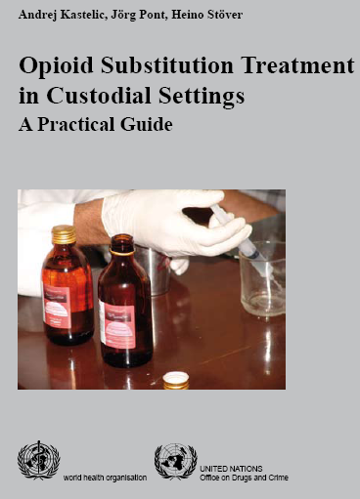
HAREACT: English, Russian, German, Polish language

Slide 18
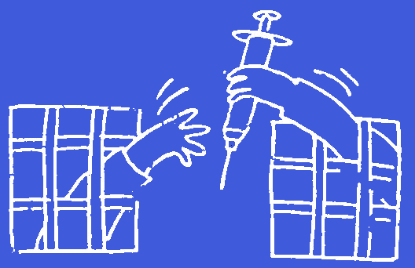
Prison-Based Needle
Exchange Programmes (PNSP) in 60 prisons worldwide – 9 countries
Notes:
18

Slide 19

„Systematic Literature Review on PNSP“
Jeffrey V Lazarus, Daniel J Bromberg, Denise Ocampo, Niels Graf, Anna Dichtl,
Heino Stöver, Hans Wolff

Slide 20

Conclusions of Systematic Literature Review:
Only nine countries in which PNSPs are currently operating – and in some of those countries, coverage is very low
Findings of our review, while qualified by these limitations, nonetheless bolster the WHO/UNODC/UNAIDS recommendation for PNSP to be provided in prisons
Notes:
10.35 million people held in prisons, more than one third of them are in pre-trial detention. The annual global prison population is significantly greater due to the high turnover; most prisoners return to the community, many in less than a year. In addition, the global incarceration rate has risen by 6% over the past 15 years to reach a staggering 144 per 100,000 Furthermore many prisons across the world are overcrowded with 113 countries noted as having a prison occupancy of more than 100%, including 22 with an occupancy above 200%. Overcrowded prisons and a bigger overall prison population, along with a high turnover, lead to an increased risk of transmission of infectious diseases not only between people in prisons, but also an increased risk of transmission in the wider community.
King’s college (2016), Prison Population List (11th Edition) - http://www.prisonstudies.org/sites/default/files/resources/downloads/world_prison_population_list_11th_edition.pdf
King’s college (2013), Prison Population List (10th Edition) - http://www.prisonstudies.org/sites/default/files/resources/downloads/wppl_10.pdf

Slide 21
Conclusions

Slide 22
Conclusions: from harm production to harm reduction
Drug using/dependent prisoners are discriminated in a double sense: (i) incarcerated for coping symptoms of their drug dependence and (ii) not benefitting from the progresses in drug treatment/harm reduction, which have been achieved in the community.
Putting drug users into prisons in high numbers (approx. 30%), means putting them at high risk of relapses, violence, sexual exploitation, debts, risks of infectious diseases.
Notes:
22

Slide 23
Challenges
More attention on the particular situation of drug users in prisons is needed
Abstinence-oriented treatment can only be one element of a comprehensive drug treatment service – it needs to be supplemented by harm reduction measures
Integration of drug using prisoners and PLWHIV: „Nothing about us without us“
Utilizing international standards for changes in treatment (e.g. the Nelson Mandela Rules, CPT)
Notes:
23

Slide 24
Contact: hstoever@fb4.fra-uas.de
Notes:
24

